Slide 1


Slide 2
Analytics Use-case using GCP BiqQuery, Data Studio and Models
Using the Google’s Bigquery public dataset covid19_open_data below analysis are conducted:
Infection rate vs Population
Infection rate vs testing
Fatalities
Cluster breakouts in certain states
Show the data on a map
Using BigQuery, prepare a predictive model on how the infection will look for a second wave coming for COID-19 in Jan/Feb-2021

Slide 3
Problem Being Solved
1. Obtain insights on how covid infection rate affects the population of a particular country ?
2. Understand how covid infection rates changes with the total testings done in a country ?
3. Study the Fatality counts across all nations
4. Study the cluster breakouts in certain states in US across all the weeks in 2020.
5. Visualize the Fatalities cases on the Map
6. Build a Machine learning model using the Google public dataset to forecast how the infection will look for a second wave coming for COID-19 in Jan/Feb-2021

Slide 4



Technology/Tool/Stack

Slide 5
Solution Architecture
Solution include injecting a data from BigQuery into AI platform jupyter notebook
Perform Preprocessing steps which are Data cleaning, Feature Engineering, Feature crossing with the help of Pandas and Numpy libraries
Perform exploratory data analysis on preprocessed data to obtain insights with the help of Matplotlib and Seaborn visualization library
Write the data into Bigquery table and explore the same in Google Data Studio by building Dashboards
Machine learning and time-series forecasting techniques are applied in order to obtain a best model which can forecast how the infection will look like beyond and end of the data which is available to us.

Slide 6
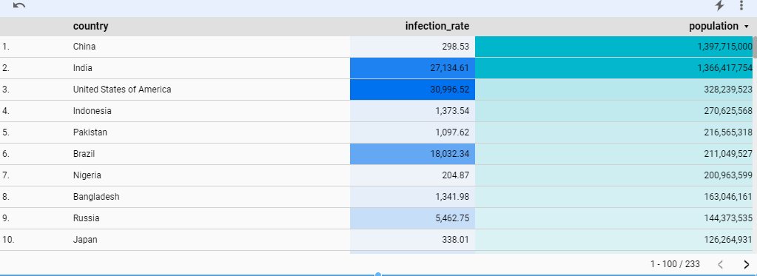
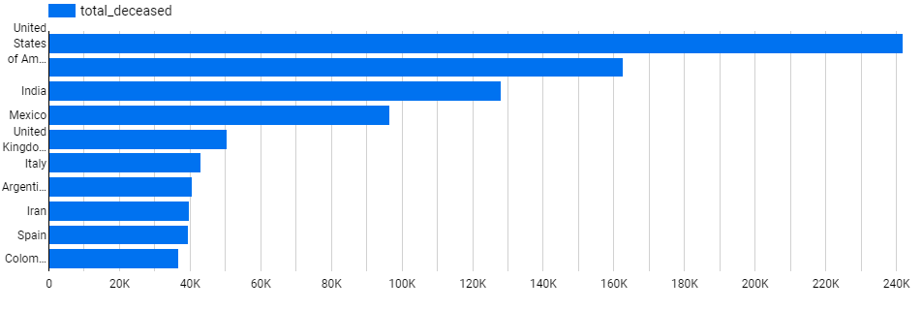
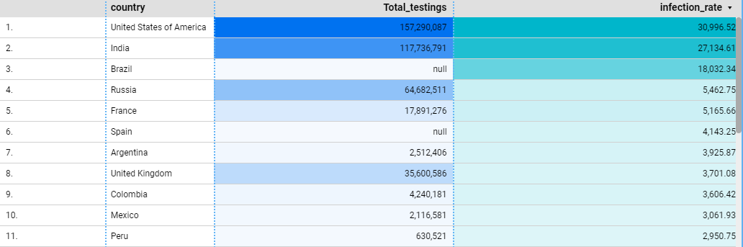
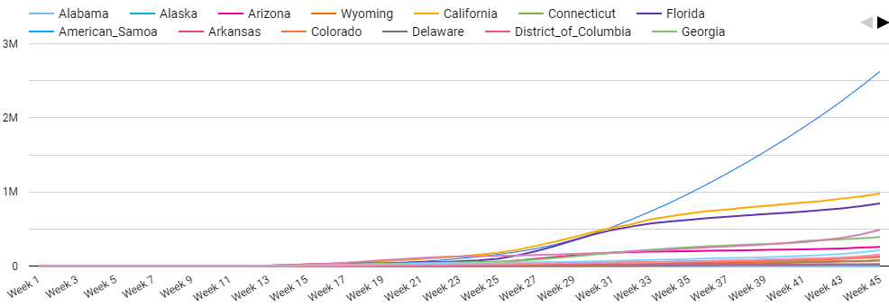
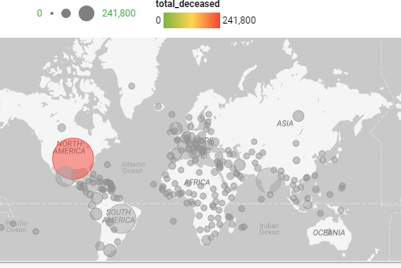

Slide 7
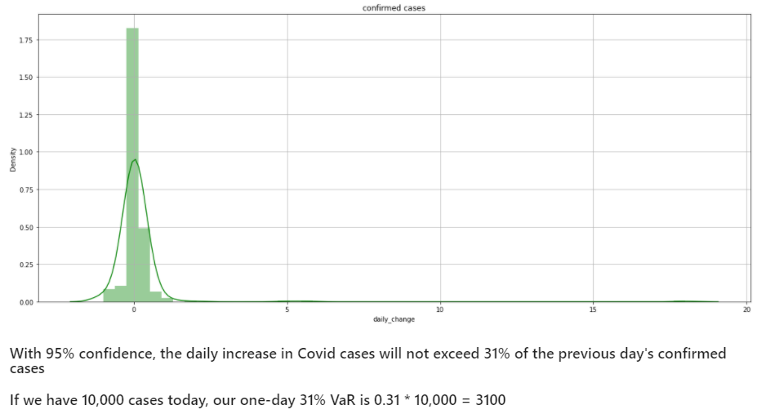
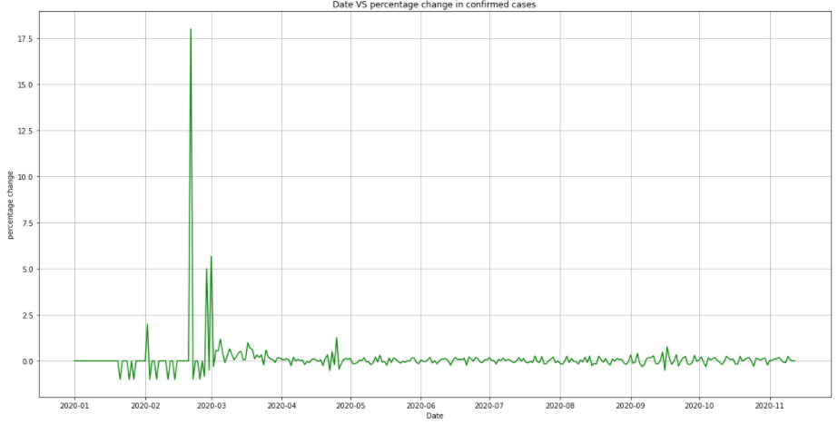
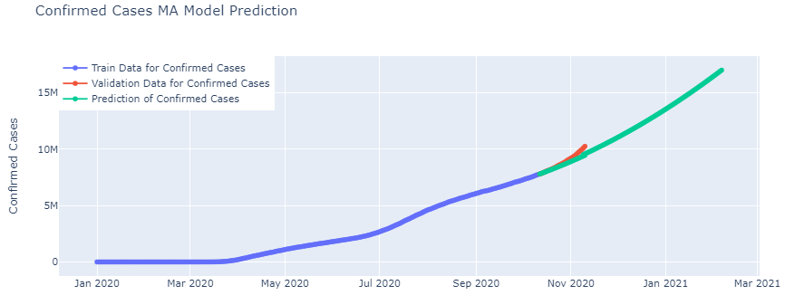
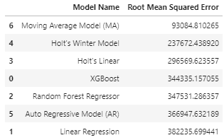

Slide 8
Challenges Faced
Insufficient volume of data – Current data set has the begin date 01-01-2020 with which the ML model tends to fail to understand the seasonality in the datapoints across a year and generalize the data well
Data quality – Too many NaN values in fields: confirmed cases and new cases in populated countries like China which poses the challenge to study the infection rates
Miss match and overlap in country code and country name

Slide 9
Future enhancements
1
Data Quality
Avoid Nan values
Handling missing values and outliers
Pipeline development
2
Machine learning pipeline which enables:
Streaming of live data
Live forecasting and update of model scores and accuracy
Object least Root mean square errors with models getting trained on new data samples

Slide 10
Links to the project
Data Studio Reports
AI platform Jupyter notebooks
https://datastudio.google.com/s/t927xDiDJ9c
https://datastudio.google.com/s/s0fWuFGgMFQ
https://datastudio.google.com/s/pD0XrbzuDqU
https://datastudio.google.com/s/l8AfCbt_lxk
https://datastudio.google.com/s/pAxWvDuJH68

Slide 11
Thank You
Shashikumar P
Ph no: 9902743848
Email: shashikumar2020s@gmail.com

